Slide 1

Beating the Market with AI
Presented by Jason, Majid, Justin, Ragini, & Souk

Slide 2
Project Approach
Note: Use trading algorithms and AI to identify the best model for trading.
Libraries:
Pandas, matplotlib, numpy, TA lib, scikit-learn

Slide 3

Scope and purpose
Note: The purpose of this project is to identify the best model to use for stock trading by testing several and testing the best on other stocks

Slide 4


Strategies Used for testing
Note: Triple EMA crossover strategy, RSI & MACD indicators, single 7 Day EMA

Slide 5
Models Explored
Note: 3 models most likely to make it to the end are:
Logistic Regression
Linear Discriminant Analysis
MLP Classifier

Slide 6

Sources for Data Collection
Note: CSV files containing stock data were pulled using Yahoo Finance

Slide 7

Demonstrations

Slide 8
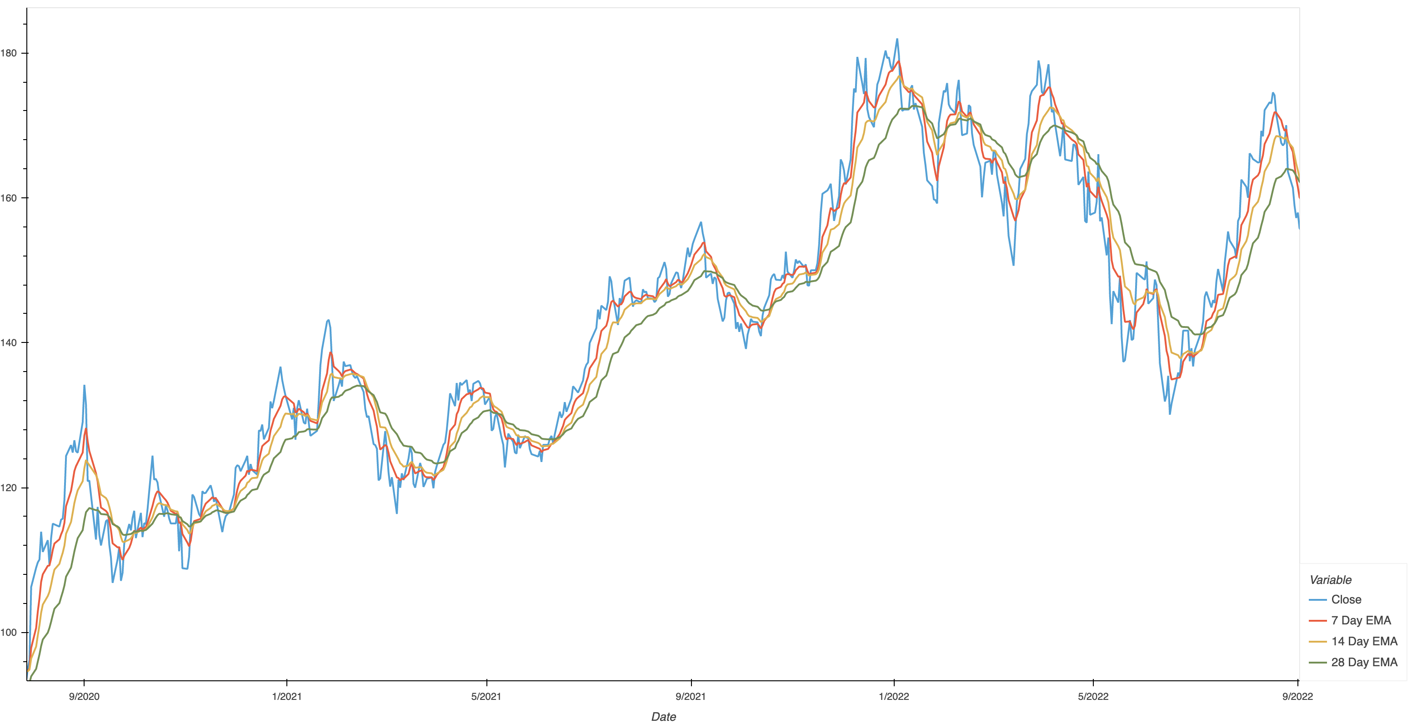
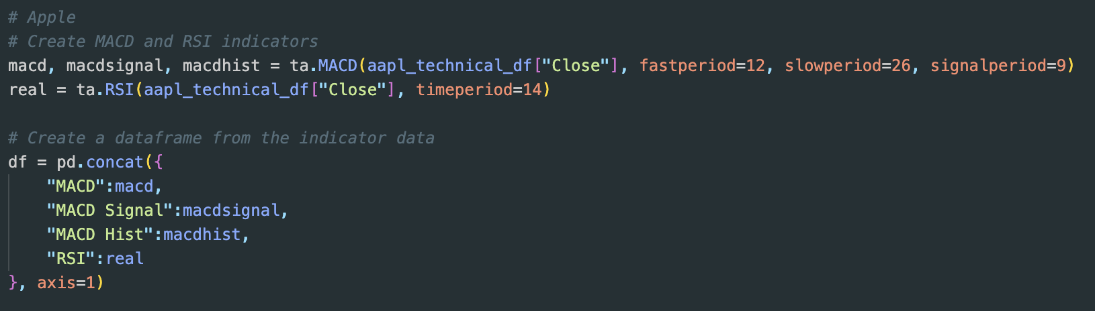
Techniques Used
Note: Temp Image

Slide 9
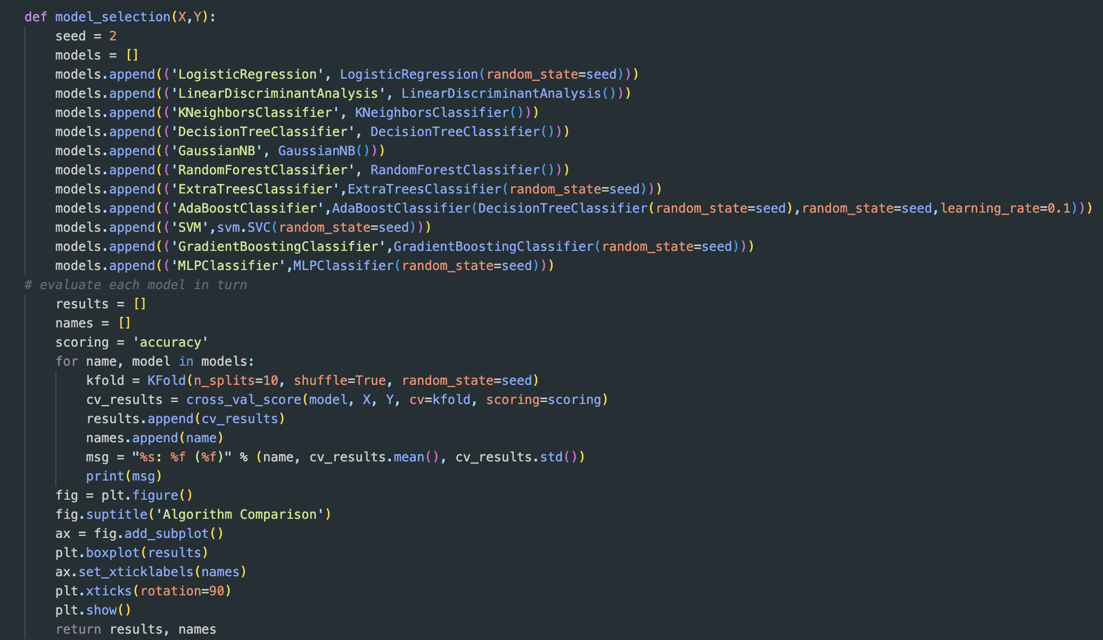
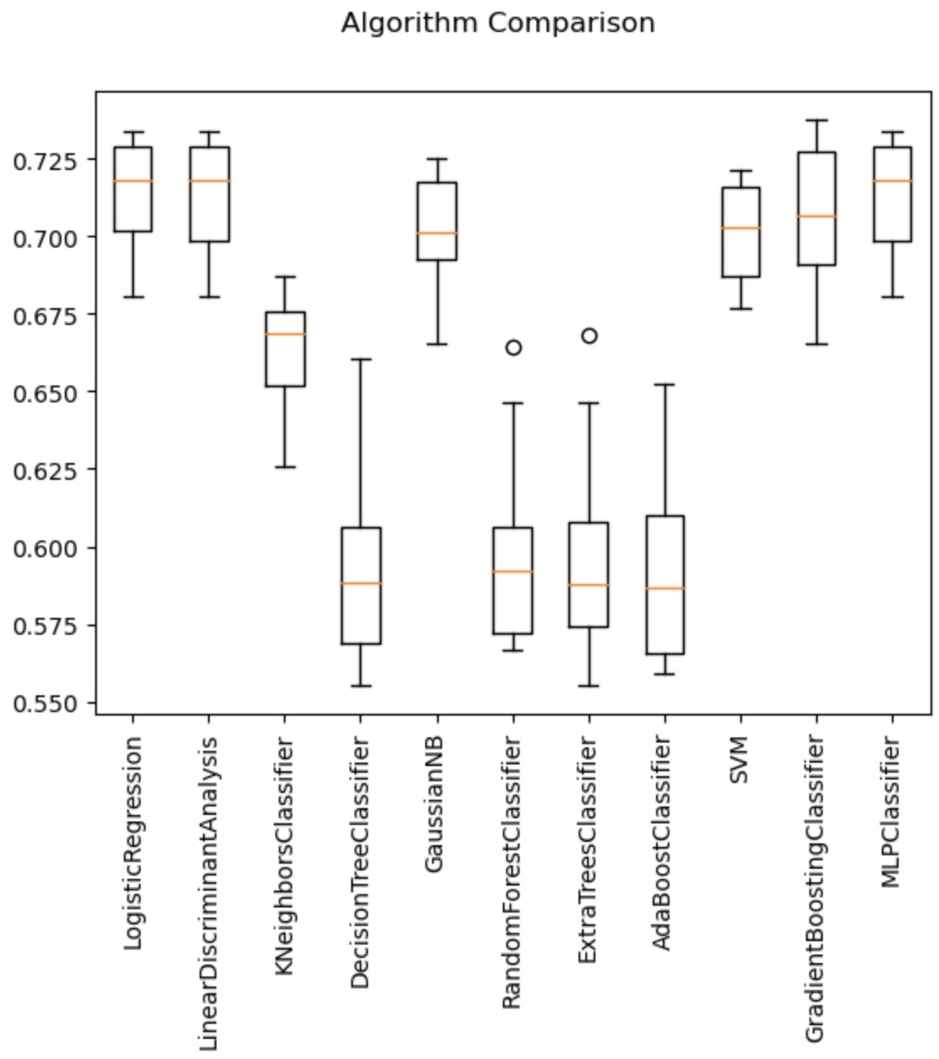
Model Framework
Note: Temp Images

Slide 10
Conclusions

Slide 11
Next Steps

